Slide 1
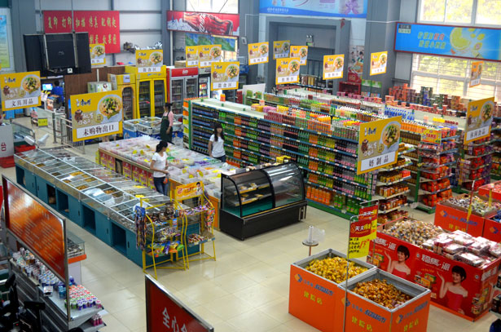
Presentation On Optimize Store Layout Presented By:- Group Three

Slide 2
> What is store optimization ??
Optimization of store in an systematic way to run an store for producing more profit.
To decide the placement of Product.
To keep the record of their customer and product.
To provide satisfaction to their customer by services.

Slide 3
> Data Set used in Project
Training
This is used for training the model.
In project we are using data set having 12 attributes/columns.
(Item_Identifier,Item_Weight, Item_Fat_Content,Item_Visibility,Item_Type,Item_MRP, Outlet_Identifier,Outlet_Establishment_Year,Outlet_Size, Outlet_Location_Type, "Outlet_Type,Item_Outlet_Sales)
Testing
This is used to test the model.
Test data set is always having less attribute then training data set.
(Item_Identifier,Item_Weight, Item_Fat_Content,Item_Visibility,Item_Type,Item_MRP, Outlet_Identifier,Outlet_Establishment_Year,Outlet_Size, Outlet_Location_Type, "Outlet_Type,Item_Outlet_Sales)

Slide 4
> Language $ Software Used In Project
Language
R language
Machine learning
Software
R Studio(Shiny App)

Slide 5
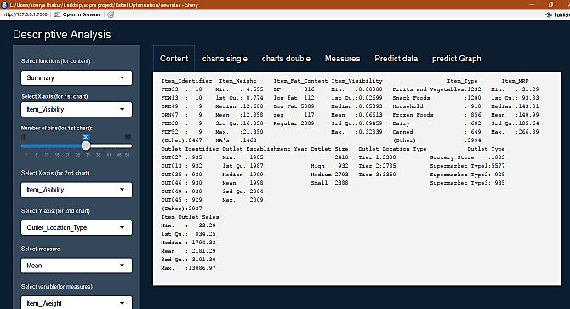
> Dashboard
For Content

Slide 6
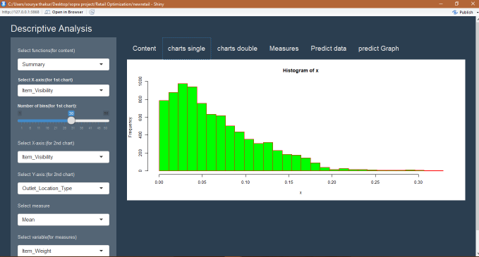
> Dashboard
For Single Chart

Slide 7
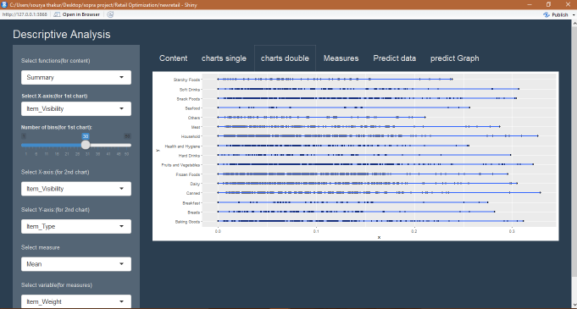
> Dashboard
For Double Chart

Slide 8
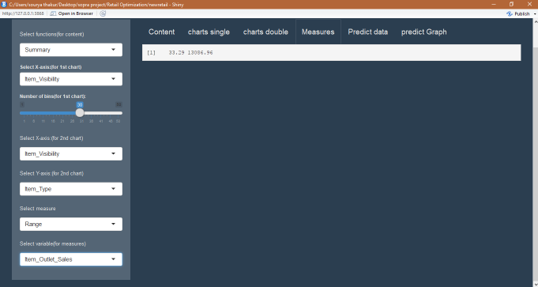
> Dashboard
For Measures

Slide 9
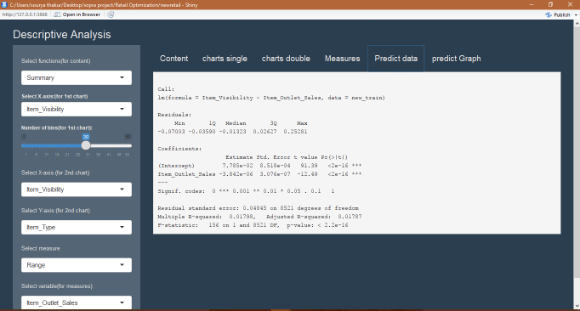
> Dashboard
For Predict Data

Slide 10
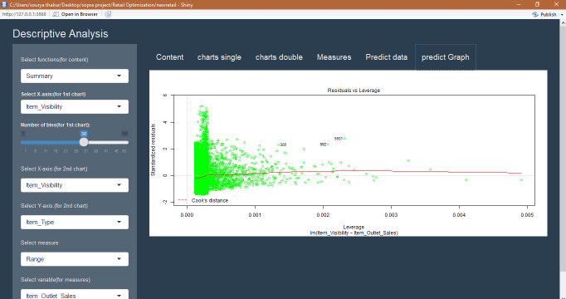
> Dashboard
For Predict Graph

Slide 11
> Conclusion
Analysis
1.Data of product(measures,Functions,Content)
2.Predict the data(using linear Regression(dependent variable~Independent variable)).
3.Can make a graph between two attributes to make an relation.

Slide 12
> References 1.https://www.analyticsvidhya.com/blog/2016/02/bigmart-sales- solution-top-20/ 2.http://archive.ics.uci.edu/ml/datasets/online+retail# 3.http://journals.sagepub.com/doi/full/10.1177/1550147717692585 4.https://github.com/VasTsak/r-exercises/blob/master/shiny_pt1.R 5.Wikipedia 6.Google 7.Youtube

Slide 13
THANK YOU

